Slide 2
Unit 5: Jenkins (5hrs)
Essentials of Continuous Integration
Architecture of Jenkins
Jenkins Tool Management System
User Management in Jenkins
Jenkins Workshop: Authentication, Authorization
Maven Overview
Creating Jobs and Automatic Build Settings
Building Delivery Pipeline. Plugin Management and Notification System

Slide 3
Once upon a time
In a bustling software company, InnovateTechNepal, a team of developers worked on a revolutionary new application.
The company was known for its innovative applications, but behind the scenes, its development process was a mess.

Slide 4
The CHAOS
Every time the team released a new version of their app, chaos erupted:
Manual Builds: Developers like Ram and Gita spent hours compiling the code, manually running tests, and packaging the application. One typo in a build command could derail an entire release.
Integration Nightmares: The team worked on different features, merging their code only at the end of the sprint. Inevitably, integrations broke, causing delays and late nights at the office.

Slide 5
The PROBLEM
Deployment Delays: Deploying the app to staging and production environments required a series of manual steps that were often inconsistent. The operations team, led by Dammar (yes, Dammar from the version control story), frequently received incomplete or buggy builds.
Slow Feedback Loops: When bugs were found, developers couldn’t trace them back to specific changes. Fixing issues was a slow and painful process, frustrating everyone involved.

Slide 6
Enter Jenkins: The Automation Hero
The team knew they needed a better way. During a lunch break, Dammar shared an idea:
“I’ve been experimenting with a tool called Jenkins,” Dammar said. “It’s like having a robot that automatically builds, tests, and deploys our app. Let me show you.”
Intrigued, the team agreed to try it.

Slide 7
The Transformation
Dammar set up Jenkins for the project. Here’s what happened next:
Automated Builds:
Jenkins took over the tedious task of compiling the code. Whenever a developer pushed changes to the Git repository, Jenkins automatically triggered a build.
Faster Feedback:
Within minutes of pushing their code, developers received reports from Jenkins about whether the build passed or failed. This fast feedback loop helped them fix issues immediately.

Slide 8
The Transformation
Continuous Integration:
Jenkins pulled the latest changes from every developer, integrated them, and ran a series of automated tests. Integration bugs were caught early, and the team stopped fearing the end-of-sprint merges.
Streamlined Deployments:
Jenkins pipelines automated the process of deploying the app to staging and production environments. What once took hours now happened in minutes, with fewer errors.

Slide 9
The Transformation
Team Productivity:
With Jenkins handling repetitive tasks, the team had more time to focus on writing code and improving the app. The developers and operations team finally worked in harmony.

Slide 10
The HAPPY ENDING
Soon, the chaos faded away:
The team at InnovateTechNepal realized that Jenkins wasn’t just a tool - it was their reliable automation partner.
By adopting Jenkins, they transformed their chaotic development and deployment process into an efficient, streamlined workflow.
From that day forward, the team delivered software faster, with greater confidence and less stress. Jenkins became their trusted ally, and InnovateTechNepal became a leader in the tech world.

Slide 11
Jenkins
Jenkins is an open-source automation server that facilitates Continuous Integration (CI) and Continuous Delivery (CD) in software development.
It helps to automate repetitive tasks such as building, testing, and deploying applications, enabling teams to focus on writing code and delivering software efficiently.

Slide 12
Why Jenkins
Manual Build Processes Are Tedious: Before tools like Jenkins, developers had to manually compile code, run tests, and deploy applications. This process was error-prone, time-consuming, and inconsistent.
Scaling Development: As projects grew in size and complexity, the need for automation tools to handle repetitive tasks and ensure consistency across environments became crucial.

Slide 13
Why Jenkins
Frequent Integration Needed: In modern development, teams often work on different features simultaneously. Without a system to regularly integrate and test code changes, integration issues pile up, delaying the project.
DevOps Evolution: Jenkins is a cornerstone of DevOps practices, fostering collaboration between development and operations teams by automating workflows.

Slide 14
Why Jenkins
Continuous Integration & Delivery: Jenkins enables CI/CD pipelines, where code changes are automatically tested and deployed, ensuring faster feedback loops and reducing time-to-market.

Slide 15
How Jenkins Works
Triggering Builds:
Jenkins automatically triggers a build when:
Code is pushed to a repository (e.g., GitHub).
Scheduled intervals or user-initiated builds are configured.
Automating Tests:
Jenkins runs automated test suites to ensure the new changes don’t break existing functionality.

Slide 16
How Jenkins Works
Continuous Integration:
New code is integrated into the main branch frequently, ensuring the application is always in a deployable state.
Continuous Delivery:
Jenkins pipelines automate the deployment of applications to staging or production environments.
Monitoring and Reporting:
Jenkins provides detailed reports on build statuses, test results, and deployment logs.

Slide 17
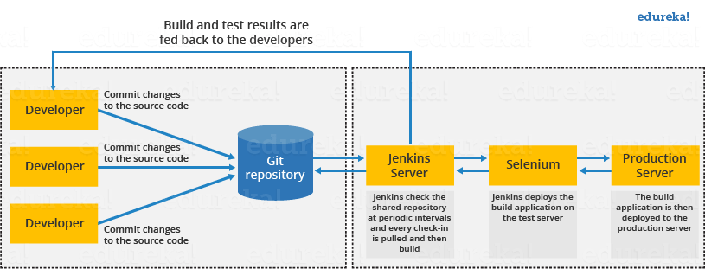
How Jenkins Works

Slide 18
Architecture of Jenkins
Jenkins follows Master-Slave (now called controller-agent) architecture to manage distributed workloads and scale CI/CD operations effectively.
In this architecture, the slave and master communicate through TCP/IP protocol.
Jenkins architecture has two components:
Jenkins Master/Server
Jenkins Slave/Node/Build Server

Slide 19
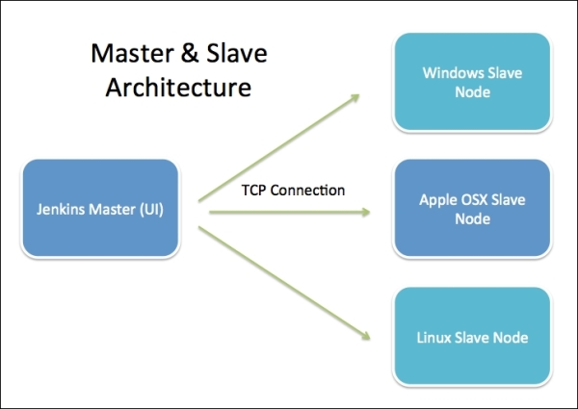
Architecture of Jenkins

Slide 20
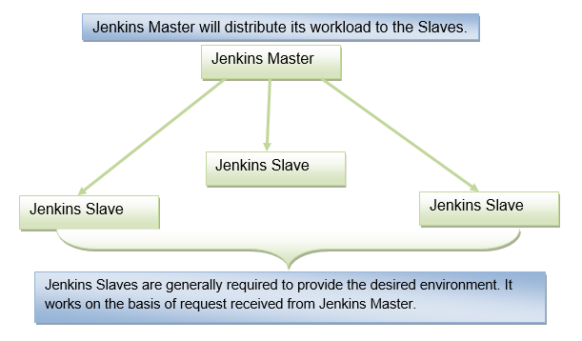
Architecture of Jenkins

Slide 21
Architecture of Jenkins – Jenkins Master
The main server of Jenkins is the Jenkins Master.
It is a web dashboard that configures these jobs/projects, and the build takes place in Nodes/Slave.
Jenkins’s server or master node holds all key configurations.
Jenkins master server is like a control server that orchestrates all the workflow defined in the pipelines.
For example, scheduling a job, monitoring the jobs, etc.

Slide 22
Architecture of Jenkins – Jenkins Master
The server's job or master's job is to handle:
Scheduling build jobs.
Dispatching builds to the nodes/slaves for the actual execution.
Monitor the nodes/slaves (possibly taking them online and offline as required).
Recording and presenting the build results.
A Master/Server instance of Jenkins can also execute build jobs directly.

Slide 23
Architecture of Jenkins – Jenkins Slave
Jenkins slave is used to execute the build jobs dispatched by the master.
When a Jenkins job is created, an agent is assigned to it.
Jenkins agents are the worker nodes that execute all the steps mentioned in a Job.
Every agent has a label as a unique identifier.

Slide 24
Architecture of Jenkins – Jenkins Slave
There are two types of Jenkins Slaves:
Static Slaves: Manually configured and always available for task execution. These agents will always be up and running and stay connected to the Jenkins server.
Dynamic Slaves: Automatically created and terminated based on demand using tools like Kubernetes or cloud integrations.

Slide 25
Architecture of Jenkins Slave

Slide 26
Architecture of Jenkins
Master-Worker Architecture:
Master Node:
Orchestrates build processes and distributes tasks.
Manages job configurations, scheduling, and monitoring.
Worker Nodes (Agents):
Execute build tasks delegated by the master.

Slide 27
Architecture of Jenkins
Pipeline:
Defines the entire CI/CD workflow using a scripted or declarative approach.
Consists of stages like build, test, and deploy.
Plugins:
Extend Jenkins functionality (e.g., Git, Docker, Kubernetes).
Over 1,500 plugins are available for integration.

Slide 28
Architecture of Jenkins
Jobs:
Individual tasks or sequences of tasks configured in Jenkins.
Examples: Build a project, run tests, deploy applications.
Build Triggers:
Automatically initiate builds based on:
Code changes in a repository.
Scheduled intervals (cron jobs).
Manual triggers or API calls.

Slide 29
Architecture of Jenkins
Distributed Builds:
Jenkins supports building across multiple worker nodes to handle large-scale projects.
Web Interface:
Intuitive dashboard to configure jobs, view build results, and manage workers.

Slide 30
Master-Slave Communication
Connection Setup:
The master connects to the slave using SSH, JNLP (Java Network Launch Protocol), or HTTP.
Task Delegation:
The master sends job details and resources to the slave.
Execution and Feedback:
The slave executes the job and sends logs, build results, and artifacts back to the master.

Slide 31
Setup Jenkins Master-Slave Configuration
Prerequisites:
Jenkins installed on the master.
Slaves with required software and permissions.
Networking: Ensure the master and slave can communicate.

Slide 32
Setup Jenkins Master-Slave Configuration
Steps:
Configure Jenkins Master:
Go to Manage Jenkins > Nodes.
Add a new node (slave).
Specify the slave name, remote working directory, and connection method (SSH or JNLP).

Slide 33
Setup Jenkins Master-Slave Configuration
Steps:
Connecting a Jenkins master and agent can be done in two ways:
Using the SSH method:
Uses the ssh protocol to connect to the agent. The connection gets initiated from the Jenkins master. There should be connectivity over port 22 between master and agent.
Using the JNLP method:
Uses java JNLP protocol (Java Network Launch Protocol). In this method, a java agent gets initiated from the agent with Jenkins master details. For this, the master nodes firewall should allow connectivity on specified JNLP port. Typically the port assigned will be 50000. This value is configurable.

Slide 34
Setup Jenkins Master-Slave Configuration
Steps:
Set Up Slave Node:
Install Java on the slave machine.
Launch the agent.jar file provided by the master to establish a connection.
For SSH, ensure proper key-based authentication.
Test Connection:
Verify the slave node is online and connected to the master.

Slide 35
Example Use Case
Scenario:
A team has a Jenkins master running on a Linux server and two slaves:
Slave 1: A Linux server for testing and building Java applications.
Slave 2: A Windows server for testing .NET applications.
Steps:
The master triggers a Java build job and delegates it to Slave 1.
The master simultaneously assigns a .NET build job to Slave 2.
Both slaves execute their tasks and return the results to the master.

Slide 36
Jenkins Tool Management System
Jenkins provides a flexible Tool Management System.
It helps configure and manage tools required for the build and deployment processes.
This feature helps to define, install, and manage various tools like Java, Maven, Git, or other custom tools without requiring them to be pre-installed on every node.

Slide 37
Jenkins Tool Management System
Tools can be configured globally in Jenkins.
Different versions of tools can be configured and assigned to specific nodes or agents.
Jenkins can download and install tools dynamically if the required plugin is installed and properly configured.
Custom tools can be configured for specific environments or projects.

Slide 38
Configuring Tools in Jenkins
Access Tool Configuration
Go to Manage Jenkins > Tools.
Add and Configure Tools
Jenkins allows to configure the following tools:
Maven: Manage Maven versions for Java projects.
JDK: Define the location or use auto-installation options.
Git: Define Git executables for version control.
Gradle: Configure Gradle for build automation.
Node.js: Manage Node.js versions and npm packages (requires NodeJS plugin).

Slide 39
Example: Adding a Tool in Jenkins
Adding JDK
Go to Manage Jenkins > Tools.
Scroll to the JDK section.
Add a new JDK installation:
Name: e.g., "Java 11".
JAVA_HOME: Path to the JDK directory (if pre-installed).
Install Automatically: Check this box to allow Jenkins to download the JDK if not already installed.
Save the configuration.

Slide 40
Example: Adding a Tool in Jenkins
Adding Maven
Go to Manage Jenkins > Tools.
Scroll to the Maven section.
Add a new Maven installation:
Name: e.g., "Maven 3.8".
MAVEN_HOME: Path to the Maven installation.
Use the "Install Automatically" option for dynamic installation.
Save the configuration.

Slide 41
Using Tools in Jobs
After configuring tools, they can be used in Jenkins jobs:
Freestyle Project:
While configuring a freestyle job, use the Build Environment section to select the tools defined in the global configuration.

Slide 42
Using Tools in Jobs
Pipeline Project:
Use the tools directive in the pipeline script to specify tools. For example:
pipeline {
agent any
tools {
maven 'Maven 3.8'
jdk 'Java 11'
}
stages {
stage('Build') {
steps {
sh 'mvn clean install'
}
}
}
}

Slide 43
User Management in Jenkins
Jenkins provides robust user management capabilities to control access and permissions within the application.
Effective user management ensures
secure collaboration
protects sensitive data
allows efficient allocation of responsibilities.

Slide 44
User Management in Jenkins
User Accounts:
Jenkins requires users to log in with a username and password or use other authentication methods.
Users can have roles or permissions assigned to them for specific tasks.

Slide 45
User Management in Jenkins
Authentication:
Verifies the identity of users trying to access Jenkins.
Common methods:
Jenkins' built-in user database.
External authentication systems (LDAP, Active Directory, SAML, OAuth, etc.).
API tokens for programmatic access.

Slide 46
User Management in Jenkins
Authorization:
Controls what authenticated users can do in Jenkins.
Supports multiple authorization strategies to grant or restrict access

Slide 47
Steps for User Management in Jenkins
Configure Authentication
Navigate to Manage Jenkins > Security.
Choose an Authentication Method:
Jenkins' Own User Database:
Default and simplest method.
Users are managed directly within Jenkins.
External Authentication:
LDAP, Active Directory, or Single Sign-On systems.

Slide 48
Steps for User Management in Jenkins
Add Users
Go to Manage Jenkins > Users.
Click Create User and fill in the details:
Username.
Password.
Full Name.
Email Address.
Save to create the user.

Slide 49
Steps for User Management in Jenkins
Set Up Authorization Strategy
Navigate to Manage Jenkins > Security.
Choose an Authorization Strategy:
Matrix-Based Security:
Fine-grained control by assigning specific permissions to users or groups.
Permissions include read, write, build, admin, etc.
Role-Based Strategy:
Define roles with specific permissions and assign them to users.
Requires the Role-Based Authorization Strategy plugin.

Slide 50
Steps for User Management in Jenkins
Set Up Authorization Strategy
Navigate to Manage Jenkins > Security.
Choose an Authorization Strategy:
Project-Based Authorization:
Define access control at the project level.
Full Access or Logged-In Users:
Grants all users the same access level.

Slide 51
Steps for User Management in Jenkins
Assign Permissions
Based on the chosen strategy, assign permissions:
Matrix-Based Security:
Use the matrix to check/uncheck permissions for users or groups.
Role-Based Strategy:
Define roles (e.g., Admin, Developer, Viewer) and their permissions.
Assign roles to users globally or for specific projects.

Slide 52
Steps for User Management in Jenkins
Manage API Tokens
API tokens allow programmatic access to Jenkins.
Generate tokens for each user by going to Manage Jenkins > Users > Select User > Security > API Token.

Slide 53
Role Based Authorization Strategy
Install the Plugin:
Go to Manage Jenkins > Plugins > Available Plugins.
Search for and install the Role-Based Authorization Strategy plugin.
Configure Roles:
Go to Manage Jenkins > Manage and Assign Roles.
Define roles like (Admin: Full access). (Developer: Can view, build, and modify jobs). (Viewer: Read-only access).
Assign Roles to Users:
Assign roles globally or on specific projects.

Slide 54
Best Practices for User Management
Grant users only the permissions they need for their tasks.
Manage permissions through groups instead of individual users for easier administration.
Regularly review access logs to ensure no unauthorized activities.
Use LDAP or Active Directory for larger teams to centralize authentication.
Use tokens instead of passwords for API-based interactions.
Keep Jenkins and plugins updated to address security vulnerabilities.

Slide 55
End of Lecture 10

Slide 56
Jenkins Workshop

